Slide 1

CHAPTER 5
SEQUENCES,
MATHEMATICAL
INDUCTION, AND
RECURSION
Copyright © Cengage Learning. All rights reserved.

Slide 2
SECTION 5.5
Application: Correctness of Algorithms
Copyright © Cengage Learning. All rights reserved.

Slide 3
Application: Correctness of Algorithms
Each program is designed to do a specific task—calculate the mean or median of a set of numbers, compute the size of the paychecks for a company payroll, rearrange names in alphabetical order, and so forth.
We will say that a program is correct if it produces the output specified in its accompanying documentation for each set of input data of the type specified in the documentation.
Most computer programmers write their programs using a combination of logical analysis and trial and error.

Slide 4
Application: Correctness of Algorithms
In order to get a program to run at all, the programmer must first fix all syntax errors (such as writing ik instead of if, failing to declare a variable, or using a restricted keyword for a variable name).
When the syntax errors have been removed, however, the program may still contain logical errors that prevent it from producing correct output.
Frequently, programs are tested using sets of sample data for which the correct output is known in advance.

Slide 5
Application: Correctness of Algorithms
And often the sample data are deliberately chosen to test the correctness of the program under extreme circumstances.
But for most programs the number of possible sets of input data is either infinite or unmanageably large, and so no amount of program testing can give perfect confidence that the program will be correct for all possible sets of legal input data.

Slide 6
Assertions

Slide 7
Assertions
Consider an algorithm that is designed to produce a certain final state from a certain initial state. Both the initial and final states can be expressed as predicates involving the input and output variables.
Often the predicate describing the initial state is called the pre-condition for the algorithm, and the predicate describing the final state is called the post-condition for the algorithm.

Slide 8
Example 1 – Algorithm Pre-Conditions and Post-Conditions
Here are pre- and post-conditions for some typical algorithms.
a. Algorithm to compute a product of nonnegative integers
Pre-condition: The input variables m and n are
nonnegative integers.
Post-condition: The output variable p equals mn.

Slide 9
Example 1 – Algorithm Pre-Conditions and Post-Conditions
cont’d
b. Algorithm to find quotient and remainder of the division
of one positive integer by another
Pre-condition: The input variables a and b are positive
integers.
Post-condition: The output variables q and r are integers
such that a = bq + r and 0 ≤ r < b.

Slide 10
Example 1 – Algorithm Pre-Conditions and Post-Conditions
cont’d
c. Algorithm to sort a one-dimensional array of real numbers
Pre-condition: The input variable A[1], A[2], . . . , A[n] is
a one-dimensional array of real numbers.
Post-condition: The output variable B[1], B[2], . . . , B[n]
is a one-dimensional array of real
numbers with same elements as A[1],
A[2], . . . , A[n] but with the property that
B[i ] ≤ B[ j ] whenever i ≤ j.

Slide 11
Loop Invariants

Slide 12
Loop Invariants
The method of loop invariants is used to prove correctness of a loop with respect to certain pre- and post-conditions. It is based on the principle of mathematical induction.
Suppose that an algorithm contains a while loop and that entry to this loop is restricted by a condition G, called the guard.
Suppose also that assertions describing the current states of algorithm variables have been placed immediately preceding and immediately following the loop.

Slide 13
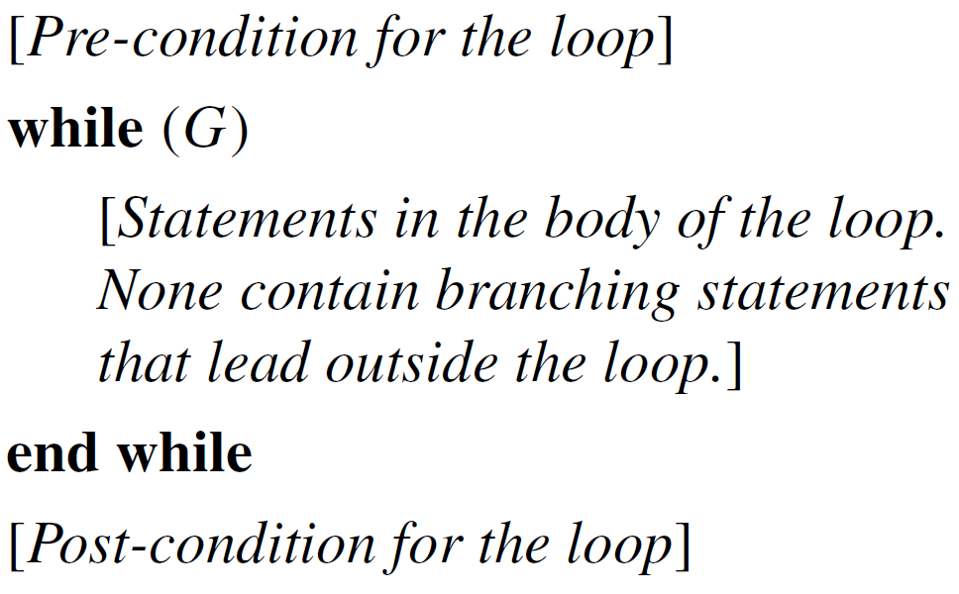
Loop Invariants
The assertion just preceding the loop is called the
pre-condition for the loop and the one just following is called the post-condition for the loop. The annotated loop has the following appearance:

Slide 14
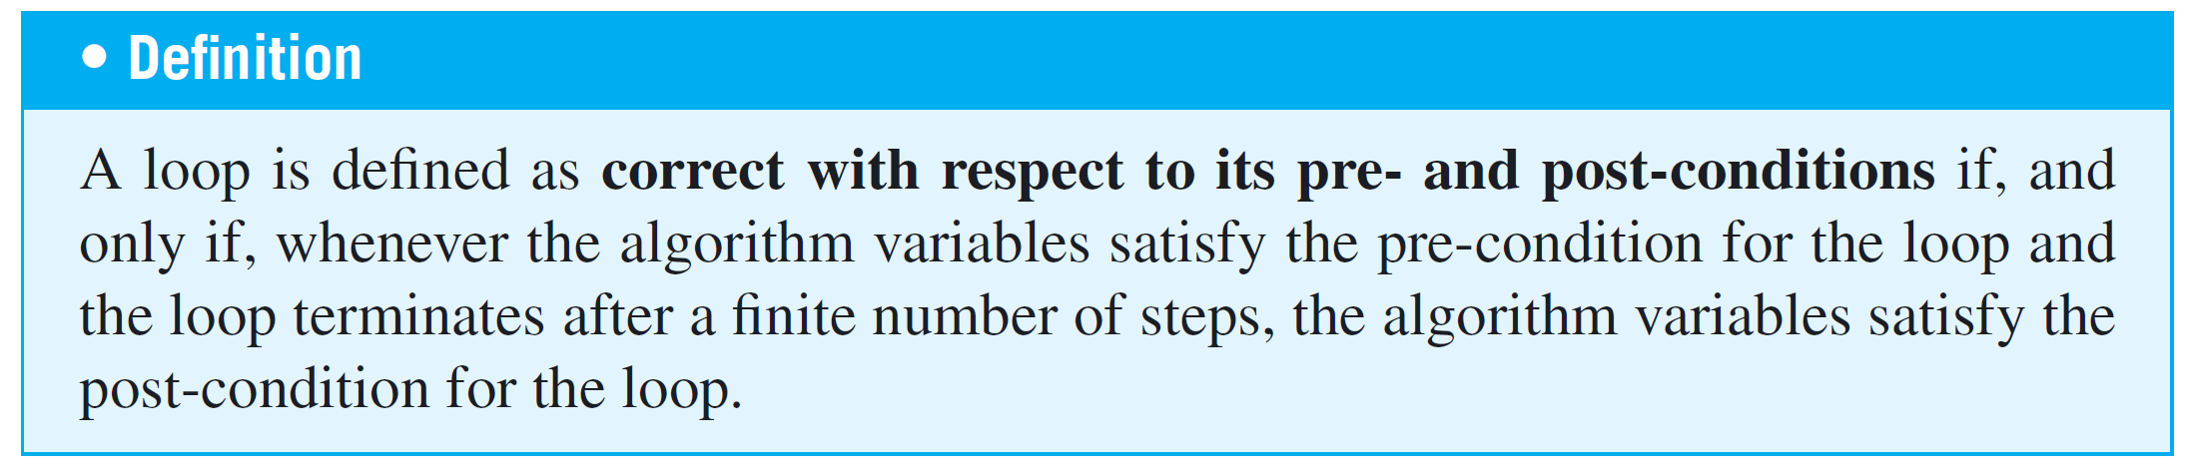
Loop Invariants
Establishing the correctness of a loop uses the concept of loop invariant. A loop invariant is a predicate with domain a set of integers, which satisfies the condition: For each iteration of the loop, if the predicate is true before the iteration, then it is true after the iteration.

Slide 15
Loop Invariants
Furthermore, if the predicate satisfies the following two additional conditions, the loop will be correct with respect to it pre- and post-conditions:
1. It is true before the first iteration of the loop.
2. If the loop terminates after a finite number of iterations,
the truth of the loop invariant ensures the truth of the
post-condition of the loop.

Slide 16
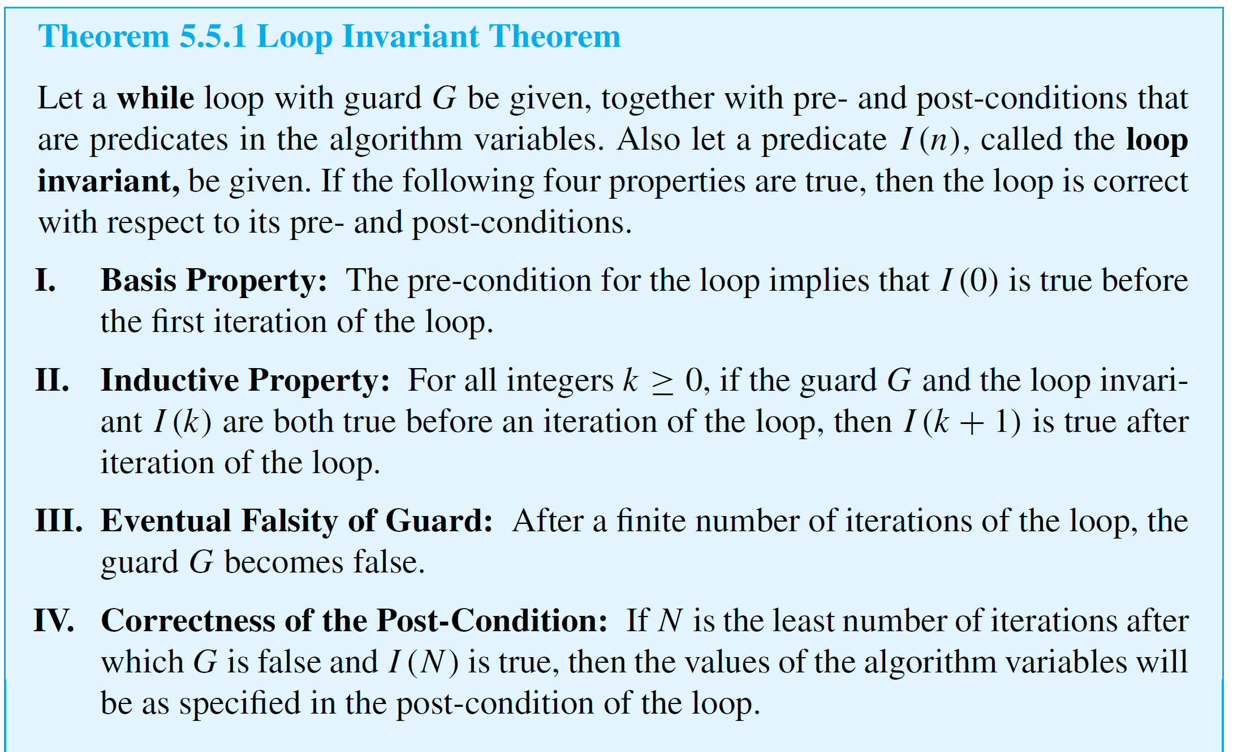
Loop Invariants
The following theorem, called the loop invariant theorem, formalizes these ideas.

Slide 17
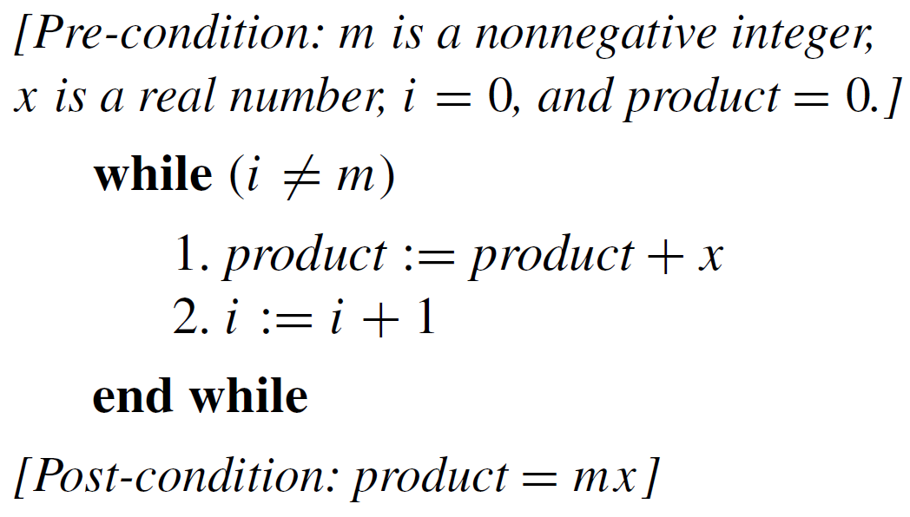
Example 2 – Correctness of a Loop to Compute a Product
The following loop is designed to compute the product mx for a nonnegative integer m and a real number x, without using a built-in multiplication operation. Prior to the loop, variables i and product have been introduced and given initial values i = 0 and product = 0.

Slide 18
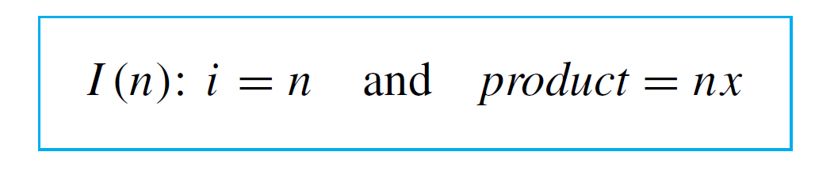
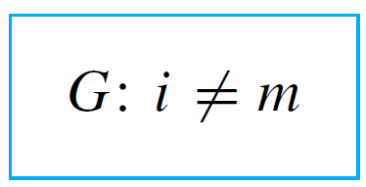
Example 2 – Correctness of a Loop to Compute a Product
cont’d
Let the loop invariant be
The guard condition G of the while loop is
Use the loop invariant theorem to prove that the while loop is correct with respect to the given pre- and
post-conditions.

Slide 19
Example 2 – Solution
I. Basis Property: [I(0) is true before the first iteration of
the loop.]
I(0) is “i = 0 and product = 0  x”, which is true before the
first iteration of the loop because 0  x = 0.
II. Inductive Property: [If G ∧ I(k) is true before a loop
iteration (where k ≥ 0), then I(k + 1) is true after the loop
iteration.]

Slide 20

Example 2 – Solution
cont’d
Suppose k is a nonnegative integer such that G ∧ I(k) is true before an iteration of the loop. Then as execution reaches the top of the loop, i ≠ m, product = kx, and i = k.
Since i ≠ m, the guard is passed and statement 1 is executed. Before execution of statement 1,
Thus execution of statement 1 has the following effect:

Slide 21
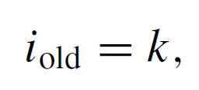

Example 2 – Solution
cont’d
Similarly, before statement 2 is executed,
so after execution of statement 2,
Hence after the loop iteration, the statement I(k + 1), namely, (i = k + 1 and product = (k + 1)x), is true. This is what we needed to show.

Slide 22
Example 2 – Solution
cont’d
III. Eventual Falsity of Guard: [After a finite number of
iterations of the loop, G becomes false.]
The guard G is the condition i ≠ m, and m is a
nonnegative integer.
By I and II, it is known that
for all integers n ≥ 0, if the loop is iterated
n times, then i = n and product = nx.
So after m iterations of the loop, i = m.
Thus G becomes false after m iterations of the loop.

Slide 23
Example 2 – Solution
cont’d
IV. Correctness of the Post-Condition: [If N is the least
number of iterations after which G is false and I(N) is
true, then the value of the algorithm variables will be as
specified in the post-condition of the loop.]
According to the post-condition, the value of product
after execution of the loop should be mx.
But if G becomes false after N iterations, i = m. And if
I(N) is true, i = N and product = Nx.
Since both conditions (G false and I(N) true) are
satisfied, m = i = N and product = mx as required.

Slide 24
Correctness of the Division Algorithm

Slide 25
Correctness of the Division Algorithm
The division algorithm is supposed to take a nonnegative integer a and a positive integer d and compute nonnegative integers q and r such that a = dq + r and 0 ≤ r < d.
Initially, the variables r and q are introduced and given the values r = a and q = 0.

Slide 26
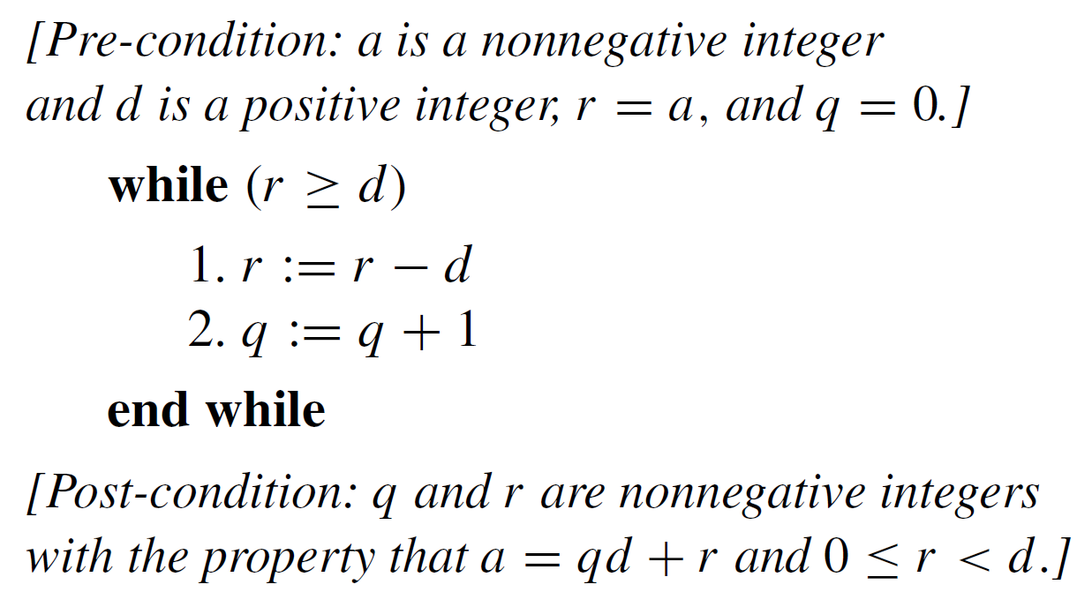
Correctness of the Division Algorithm
The crucial loop, annotated with pre- and post-conditions, is the following:

Slide 27
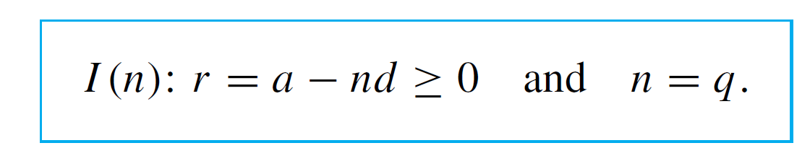
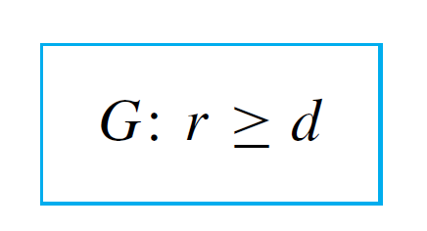
Correctness of the Division Algorithm
Proof:
To prove the correctness of the loop, let the loop invariant be
The guard of the while loop is

Slide 28
Correctness of the Division Algorithm
I. Basis property: [I(0) is true before the first iteration of
the loop.]
I(0) is “r = a – 0  d ≥ 0 and q = 0.” But by the
pre-condition, r = a, a ≥ 0, and q = 0. So since
a = a – 0  d, then r = a – 0  d and I(0) is true before the
first iteration of the loop.
II. Inductive Property: [If G ∧ I(k) is true before an
iteration of the loop (where k ≥ 0), then I(k + 1) is true
after iteration of the loop.]

Slide 29



Correctness of the Division Algorithm
Suppose k is a nonnegative integer such that G ∧ I(k) is
true before an iteration of the loop. Since G is true, r ≥ d
and the loop is entered. Also since I(k) is true,
r = a – kd ≥ 0 and k = q. Hence, before execution of
statements 1 and 2,
When statements 1 and 2 are executed, then,
and

Slide 30

Correctness of the Division Algorithm
In addition, since r_{old} ≥ d before execution of statements
1 and 2, after execution of these statements,
Putting equations (5.5.2), (5.5.3), and (5.5.4) together
shows that after iteration of the loop,
Hence I(k + 1) is true.

Slide 31
Correctness of the Division Algorithm
III. Eventual Falsity of the Guard: [After a finite number of
iterations of the loop, G becomes false.]
The guard G is the condition r ≥ d. Each iteration of the
loop reduces the value of r by d and yet leaves r
nonnegative.
Thus the values of r form a decreasing sequence of
nonnegative integers, and so (by the well-ordering
principle) there must be a smallest such r, say r_{min}.

Slide 32
Correctness of the Division Algorithm
Then r_{min} < d. [If r_{min} were greater than d, the loop would
iterate another time, and a new value of r equal to
r_{min} – d would be obtained. But this new value would be
smaller than r_{min} which would contradict the fact that r_{min}
is the smallest remainder obtained by repeated iteration
of the loop.]
Hence as soon as the value r = r_{min} is computed, the
value of r becomes less than d, and so the guard G is
false.

Slide 33


Correctness of the Division Algorithm
IV. Correctness of the Post-Condition: [If N is the least
number of iterations after which G is false and I(N) is
true, then the values of the algorithm variables will be
as specified in the post-condition of the loop.]
Suppose that for some nonnegative integer N, G is false
and I(N) is true. Then r < d, r = a – Nd, r ≥ 0, and q = N.
Since q = N, by substitution,
Or, adding qd to both sides,

Slide 34

Correctness of the Division Algorithm
Combining the two inequalities involving r gives
But these are the values of q and r specified in the
post-condition, so the proof is complete.

Slide 35
Correctness of the Euclidean Theorem

Slide 36
Correctness of the Euclidean Theorem
The Euclidean algorithm is supposed to take integers A and B with A > B ≥ 0 and compute their greatest common divisor. Just before the crucial loop, variables a, b, and r have been introduced with a = A, b = B, and r = B.

Slide 37
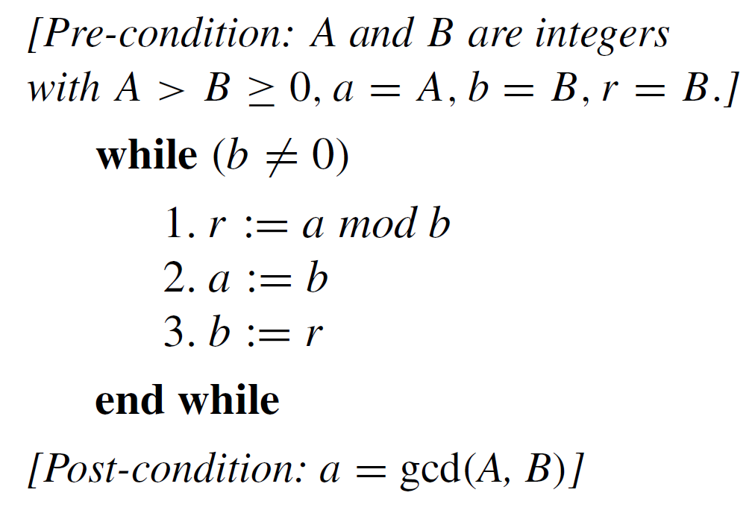
Correctness of the Euclidean Theorem
The crucial loop, annotated with pre- and post-conditions, is the following:

Slide 38
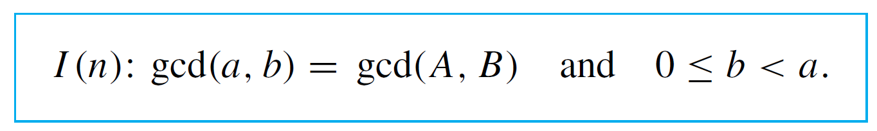
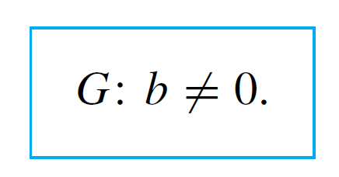
Correctness of the Euclidean Theorem
Proof:
To prove the correctness of the loop, let the invariant be
The guard of the while loop is

Slide 39
Correctness of the Euclidean Theorem
I. Basis Property: [I(0) is true before the first iteration of
the loop.]
I(0) is
According to the pre-condition,
Hence gcd(A, B) = gcd(a, b). Since 0 ≤ B < A, b = B, and
a = A then 0 ≤ b < a. Hence I(0) is true.

Slide 40

Correctness of the Euclidean Theorem
II. Inductive Property: [If G ∧ I(k) is true before an
iteration of the loop (where k ≥ 0), then I(k + 1) is true
after iteration of the loop.]
Suppose k is a nonnegative integer such that G ∧ I(k) is
true before an iteration of the loop. [We must show that
I(k + 1) is true after iteration of the loop.] Since G is true,
b_{old} ≠ 0 and the loop is entered. And since I(k) is true,
immediately before statement 1 is executed,

Slide 41

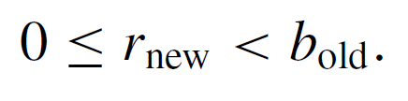




Correctness of the Euclidean Theorem
After execution of statement 1,
Thus, by the quotient-remainder theorem,
and r_{new} has the property that
By Lemma 4.8.2,
So by the equation of (5.5.5),

Slide 42






Correctness of the Euclidean Theorem
When statements 2 and 3 are executed,
Substituting equations (5.5.8) into equation (5.5.7) yields
And substituting the values from the equations in (5.5.8)
into inequality (5.5.6) gives
Hence after the iteration of the loop, by equation (5.5.9)
and inequality (5.5.10),
which is I(k + 1). [This is what we needed to show.]

Slide 43
Correctness of the Euclidean Theorem
III. Eventual Falsity of the Guard: [After a finite number of
iterations of the loop, G becomes false.]
Each value of b obtained by repeated iteration of the
loop is nonnegative and less than the previous value of b.

Slide 44
Correctness of the Euclidean Theorem
Thus, by the well-ordering principle, there is a least value
b_{min}. The fact is that b_{min} = 0.
[If b_{min} is not 0, then the guard is true, and so the loop is
iterated another time. In this iteration a value of r is
calculated that is less than the previous value of b, b_{min}.
Then the value of b is changed to r, which is less than
b_{min}. This contradicts the fact that b_{min} is the least value of
b obtained by repeated iteration of the loop. Hence
b_{min} = 0.]
Since b_{min} = 0, the guard is false immediately following
the loop iteration in which b_{min} is calculated.

Slide 45
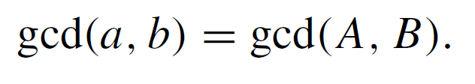

Correctness of the Euclidean Theorem
IV. Correctness of the Post-Condition: [If N is the least
number of iterations after which G is false and I(N) is
true, then the values of the algorithm variables will be
as specified in the post-condition.]
Suppose that for some nonnegative integer N, G is
false and I(N) is true. [We must show the truth of the
post- condition: a = gcd(A, B).] Since G is false, b = 0,
and since I(N) is true,

Slide 46

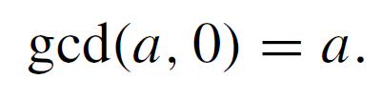
Correctness of the Euclidean Theorem
Substituting b = 0 into equation (5.5.11) gives
But by Lemma 4.8.1,
Hence a = gcd(A, B) [as was to be shown].

